Slide 1
Neural network and learning machines
Neural Network
Multi layer Perceptron (MLP)
Instructor: Ahmed Yousry

Slide 2
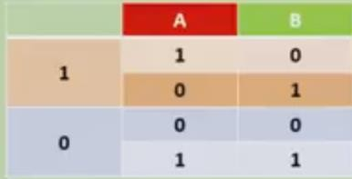
Classification Example
XOR

Slide 3
Neural NN
input
Hidden
Output

Slide 4
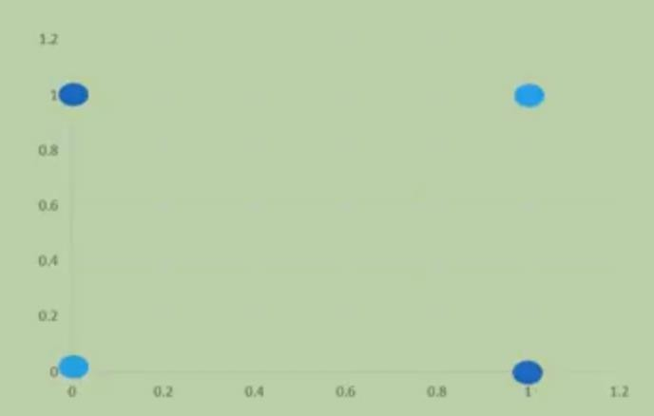
Neural NN

Slide 5
Neural NN

Slide 6
Neural NN

Slide 7
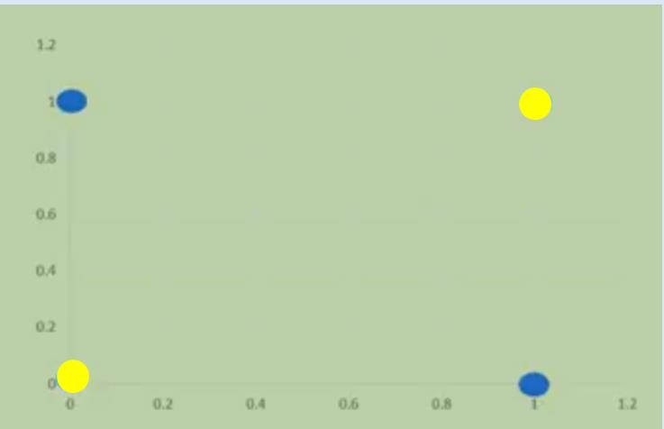
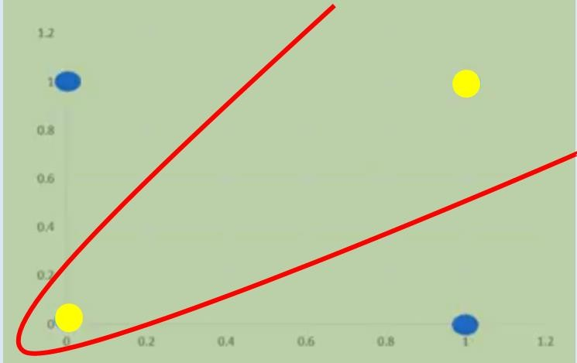

Slide 8
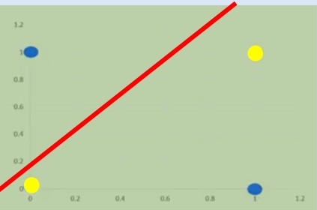
input
Output
A
W1
1/0
W2
B

Slide 9
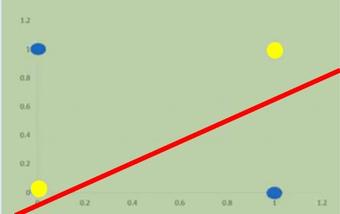
input
Output
A
W3
1/0
W4
B

Slide 10
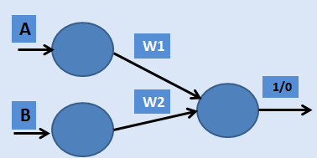


Slide 11
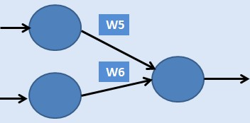

Slide 12
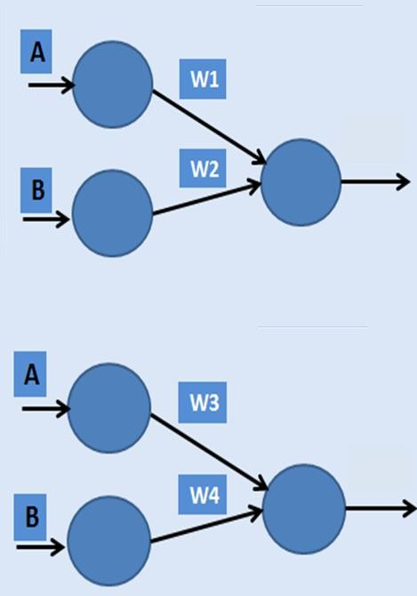
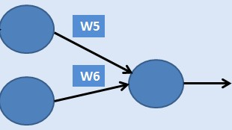

Slide 13
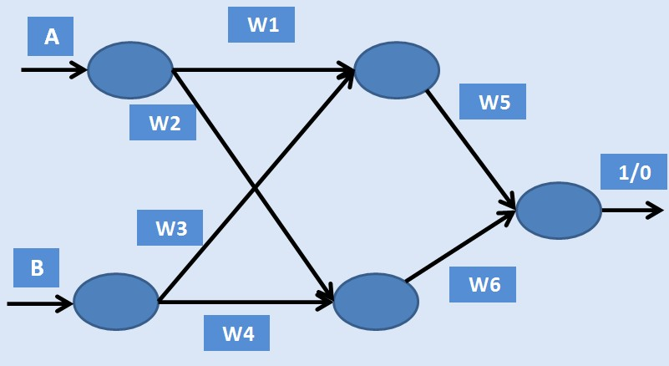

Slide 14


More complex example

Slide 15
hidden
input
output
A
W1 W2
W5
1/0
B
W3 W4
W6
Weights =W_{i}

Slide 16
Activation function input
input
hidden
output
A
W1 W2
W5
1/0
Y_{i}
B
W3 W4
W6

Slide 17
Activation function input
input
hidden
output
A
W1 W2
W5
x1
1/0
B
S= sop (X_{i},W_{i})
s
W3 W4
W6
S = ∑^{m} x w
x2
1
i i

Slide 18
Activation function input
input
hidden
output
A
W1 W2
W5
x1
1/0
B
s
W3 W4
W6
x2
Sop=x1w1+x2w3

Slide 19
Activation function input
input
hidden
output
A
W1 W2
W5
x1
1/0
B
s
W3 W4
W6
x2
Sop=x1w2+x2w4

Slide 20
Activation function input
input
hidden
output
A
W1 W2
W5
x1
1/0
B
s
W3 W4
W6
x2
Sop=s1w5+s2w6

Slide 21
Activation function output
input
hidden
output
A
W1 W2
W5
x1
1/0
B
s F(s)
W3 W4
W6
x2

Slide 22
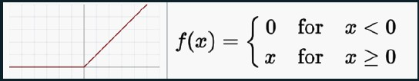

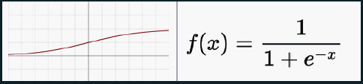


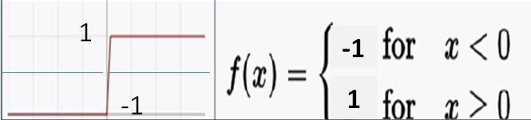

Activation Function types
ReLU
 | Softplus
 | Tanh
Sigmoid/logistic
Binary |  | Signum
Softmax

